Slide 1
CS534 Spring 2019
Project Part Ⅱ
--Sudoku
Presentation by: Yichen Li, Jiayi Li
Notes:
We are showcase for Adversarial Search and Game Playing
We are …, …
*Don’t mention all the names we will put in for showcasing work by: ….

Slide 2
Introduction
What is Sudoku?
Sudoku is a logic-based, combinatorial number-placement puzzle. The objective is to fill a 9×9 grid with digits so that each column, each row, and each of the nine 3×3 subgrids that compose the grid contain all of the digits from 1 to 9. The puzzle setter provides a partially completed grid, which for a well-posed puzzle has a single solution.
Notes:
Winner has more territory + captured stones
Compared to chess which is 10^120
-Justin

Slide 3
Introduction
What we do?
We implement a program that could solve classic 9*9 sudoku problem. Beside that, we expand our program and make it compatible with all n*n sudoku problem.
Notes:
Winner has more territory + captured stones
Compared to chess which is 10^120
-Justin

Slide 4
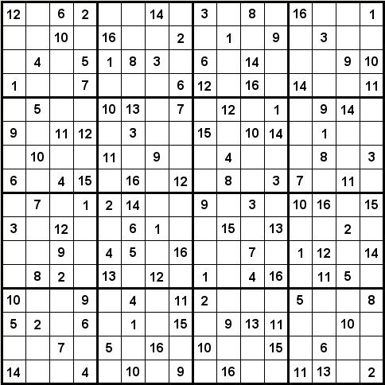
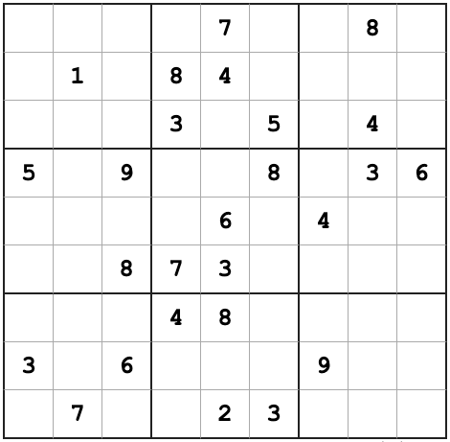
Detailed description
Variables: [0,0] [1,0] [2,3]........
Values: 0,1,2,3,...,dimension (dimension=9/16/25/...)
Constraints: Alldiff (row), Alldiff(column), Alldiff(3*3 / 4*4 / 5*5 /…)

Slide 5
Implementation
Class csp(variable, domain, neighbours, constraints)
Extends class of part 1
Input file
Instantiate SudokuCSP
Assign known squares
AC3
Naked triples
Get the dimension from the input
CSP graph
Reduce values for some variables
Reach Goal?
Result
YES
AC3
Backtracking
Minimum remaining heuristic
NO
Naked triples
In any unit (row, column or box), find three squares that each have a domain that contains the same three numbers or a subset of those numbers
(1,4)
(3,4)
(1,3,4)

Slide 6
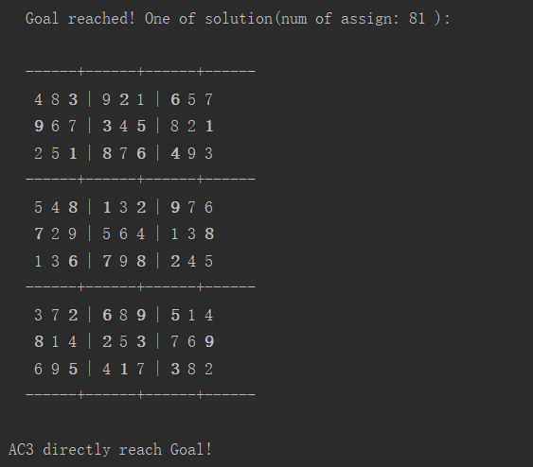
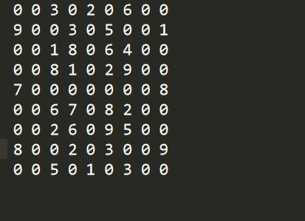
Test Result
9*9
Directly solved by AC-3

Slide 7
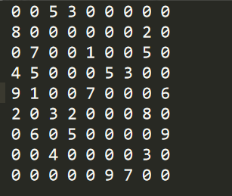

Test Result
9*9
No result

Slide 8
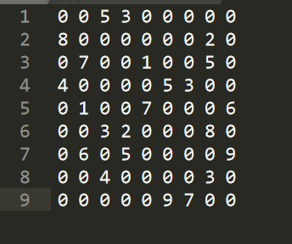
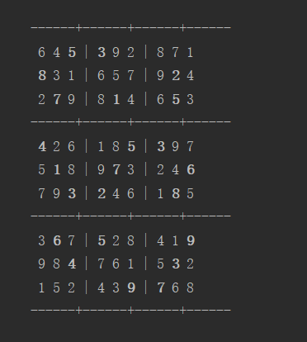
Test Result
9*9

Slide 9
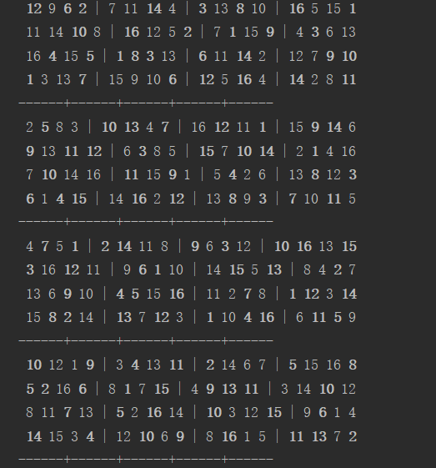
Test Result
16*16

Slide 10
Conclusion
Good expansibility
Theoretically support all n * n sudoku problem
Good efficiency when solve classical sudoku
When solving 9*9 and 16*16 sudoku problem, our program has a good efficiency.
Low efficiency when solve complicated sudoku problem
When solving 25*25 sudoku, our program spend a lot of time and space.

Slide 11
Thank you!
Questions
Notes:
*End here, last slide

Slide 12
Backup Slides

